Slide 1
Capstone Project on Football data
Name: Mr. Divyam Kandpal
Enrolment Number: EN12025082260
Batch Code: DA326S32
Mentor: Mrs. Komilla Bhatia

Slide 2
Areas of Interest
1. Performance Analysis
Business Objective: To identify and track key performance indicators (KPIs) that directly influence team success, such as goal-scoring efficiency and match attendance, enabling clubs to enhance team performance.
2. Player Profile and Market Value
Business Objective: To evaluate the factors influencing a player’s market value, such as nationality and team association, and optimize player acquisition or retention based on this analysis.
3. Team Comparison
Business Objective: To compare team performances based on key statistics, such as goal-scoring patterns and market value, in order to improve team composition, match strategies, and financial planning.
4. Attendance and Stadium Analysis
Business Objective: To analyze stadium attendance patterns and how they relate to home team performance, driving strategies to increase attendance through performance improvements and fan engagement initiatives.
5. Referee Analysis
Business Objective: To analyze the impact of referees on match outcomes, particularly in terms of disciplinary actions (yellow/red cards), to better understand game control and referee consistency.

Slide 3
6. Substitution Patterns
Business Objective: To optimize team substitutions by analyzing the timing and impact of substitutions on match outcomes, such as scoring or conceding goals, and identifying which players are more effective post-substitution.
7. Event Analysis
Business Objective: To examine match events (e.g., goals, fouls, corners) and their correlation with game outcomes, helping teams better prepare for matches by analyzing event-based patterns that can be used in strategy formulation.
8. Competition Analysis
Business Objective: To analyze team performances across different competitions and assess trends in scoring and match outcomes to help teams develop strategies for varying competition levels.
9. Player Attributes and Demographics
Business Objective: To assess how player attributes like position, nationality, and age affect market value and performance, guiding recruitment and talent management decisions for optimal team building.
10. Contract Management
Business Objective: To manage player contracts effectively by analyzing contract expiration timelines and performance trends, ensuring timely contract renewals and avoiding financial overcommitments to declining players.

Slide 4
Problem Statement of the Football Data Capstone Project
The Football Data Capstone Project uses data to help football teams make smarter decisions. It looks at player performance, market value, and team strategies by analyzing key factors like goals, minutes played, and match attendance. The project uses models to predict things like who might become team captain, how much a player is worth, and what events will happen during a game. It also helps with managing player contracts and improving fan attendance. Overall, the project shows how data can improve decisions, helping teams perform better and make the most of their resources.

Slide 5
Tools used
Jupyter notebook – I have used python for merging the tables, cleaning and treating missing value treatment. All the ML models have been made here.
Tableau – I have used Tableau for creating various charts for data visualization and interpreting the data.

Slide 6
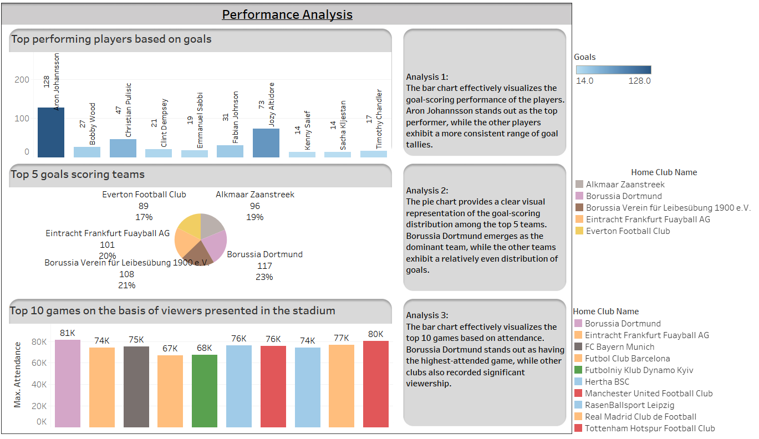

Slide 7
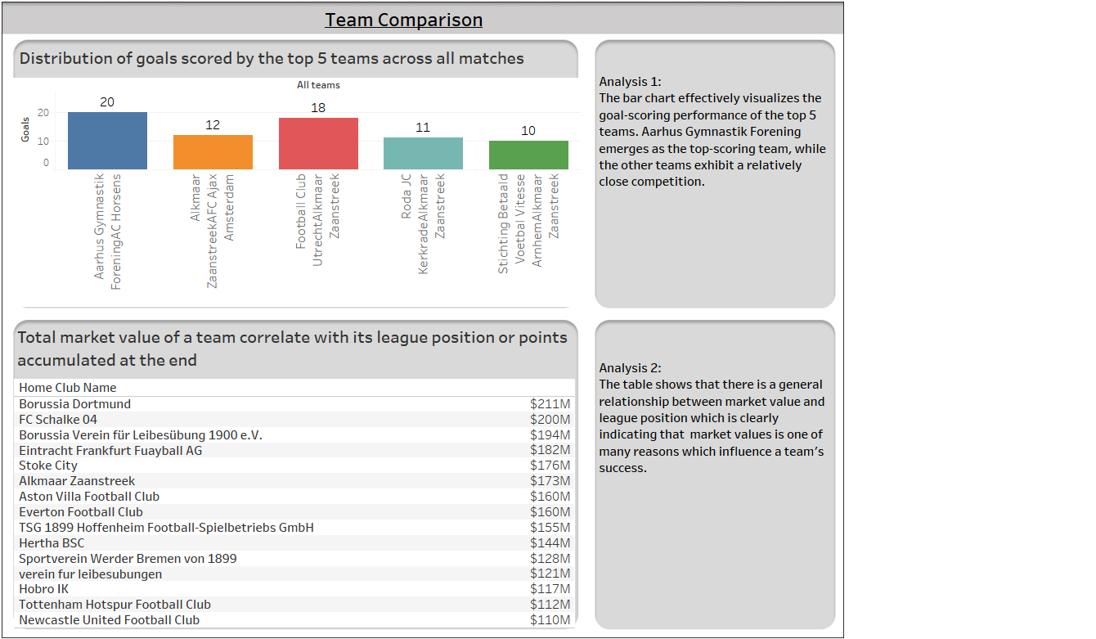

Slide 8
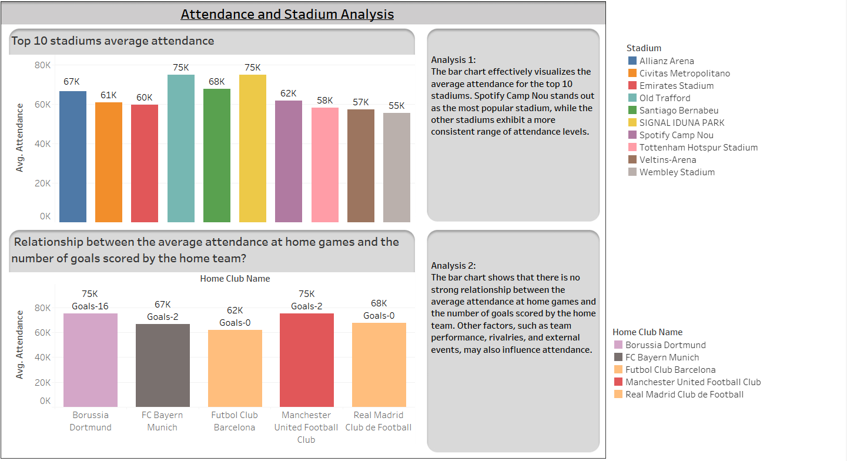

Slide 9
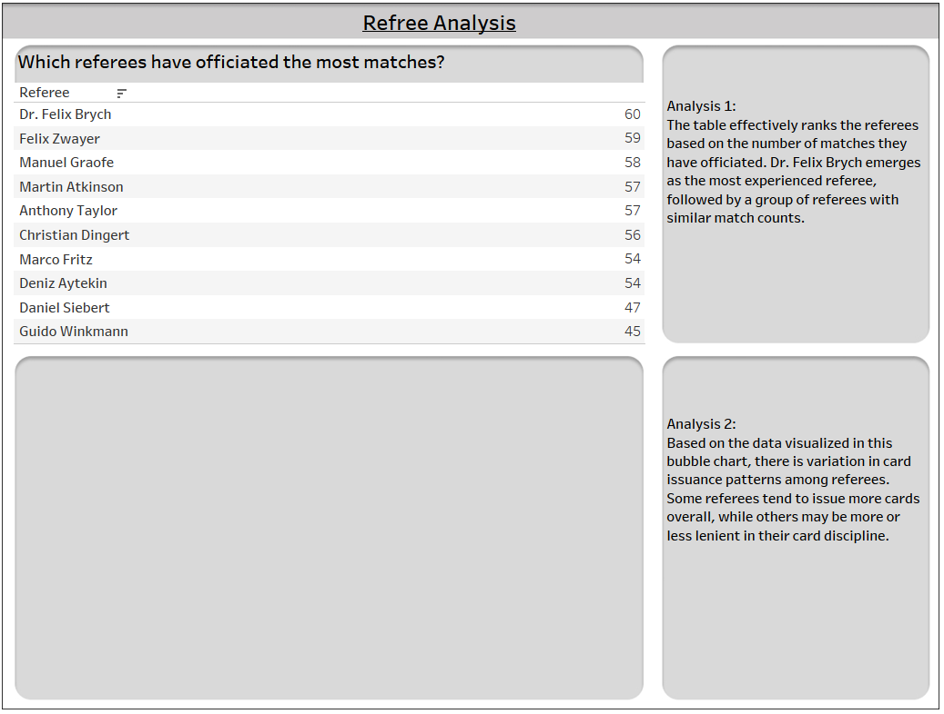
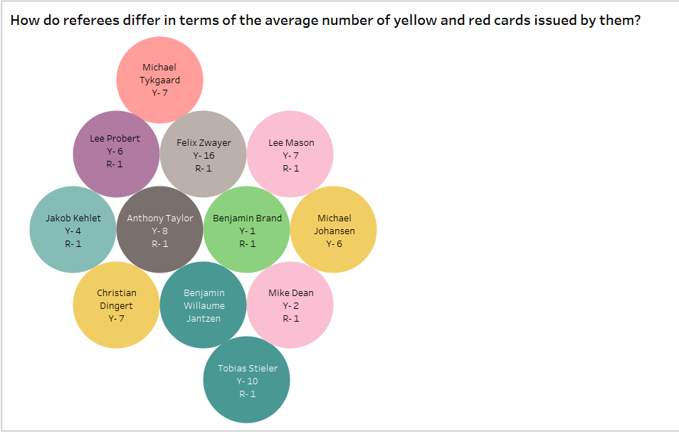

Slide 10
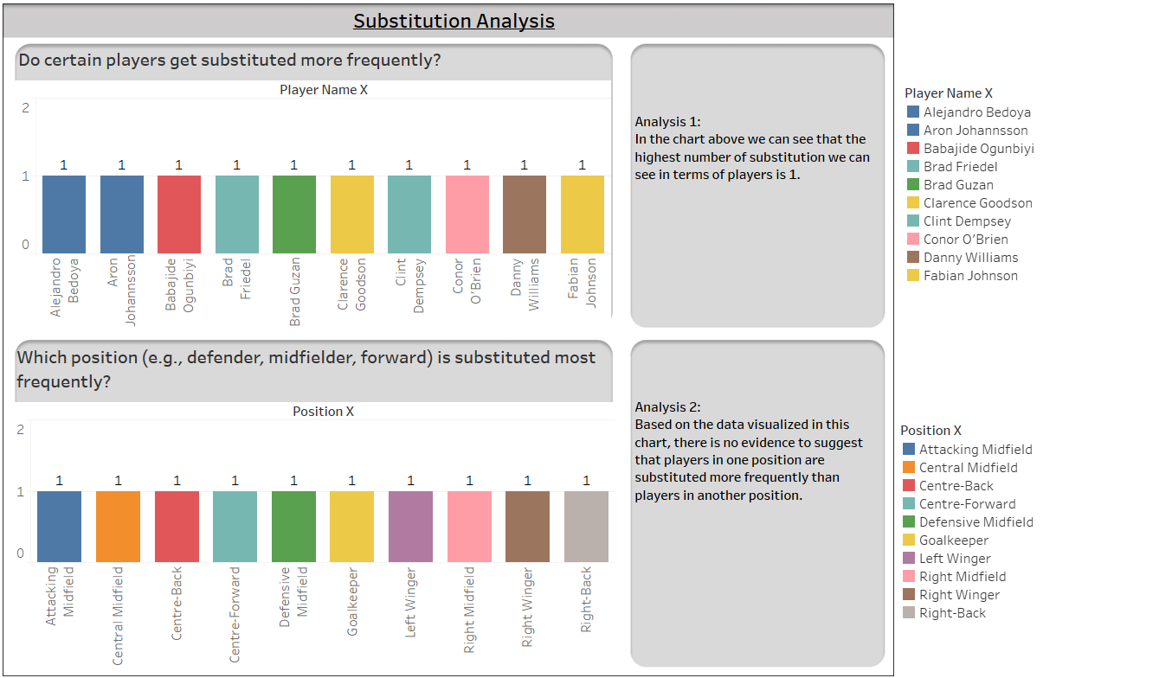

Slide 11
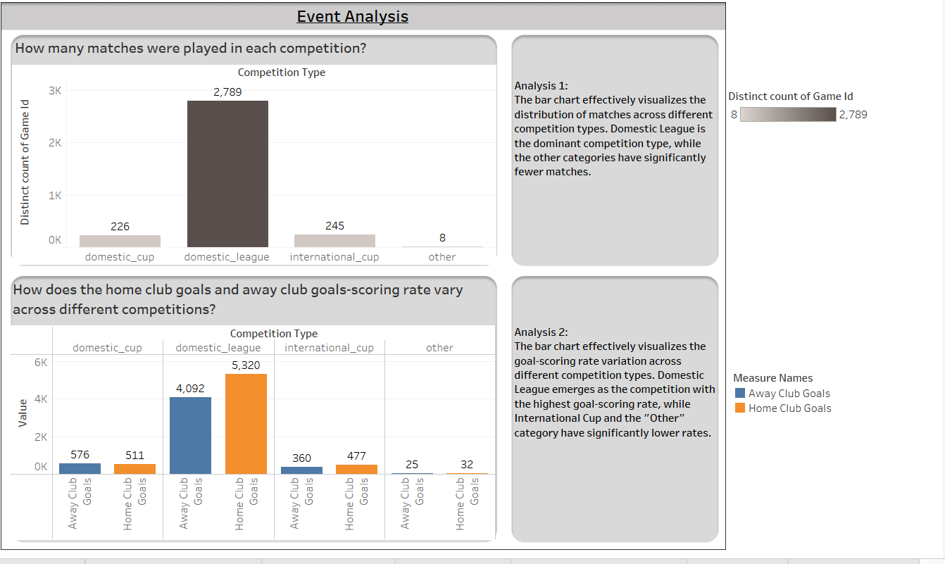

Slide 12
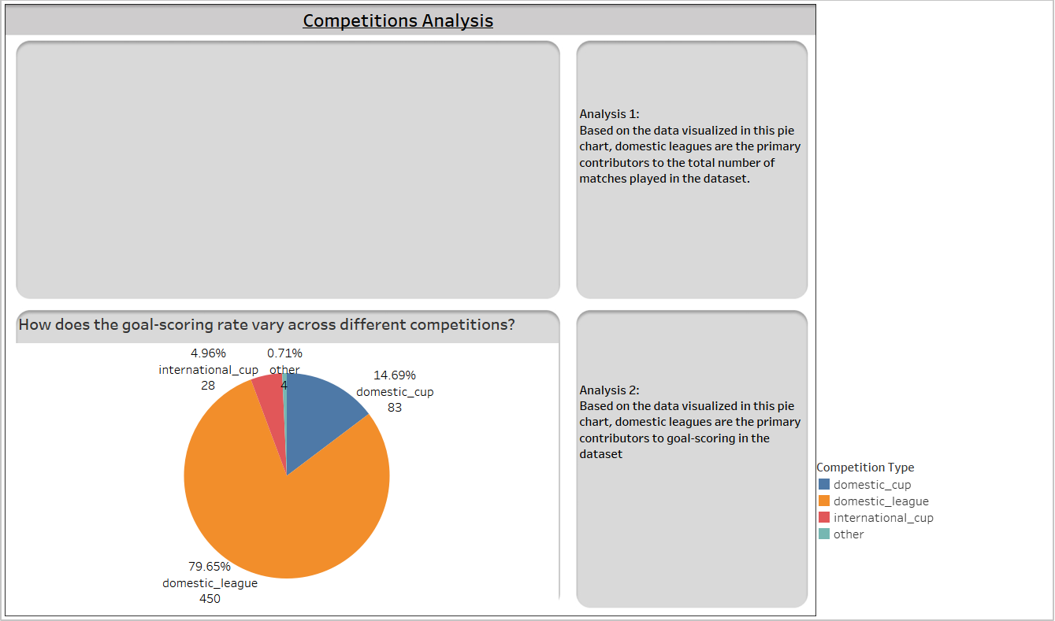
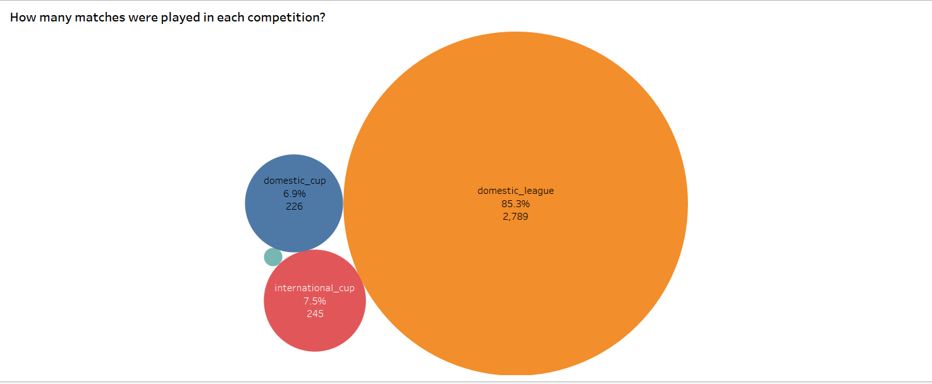

Slide 13
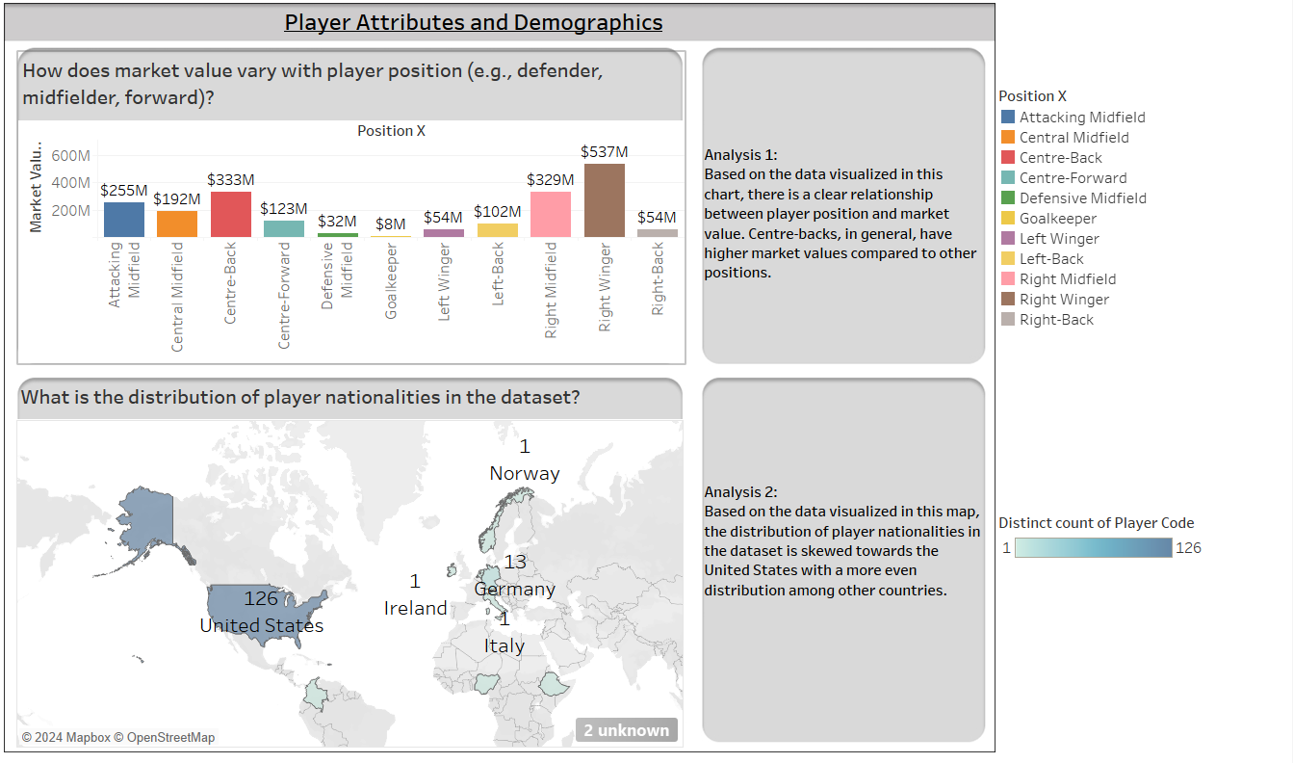

Slide 14
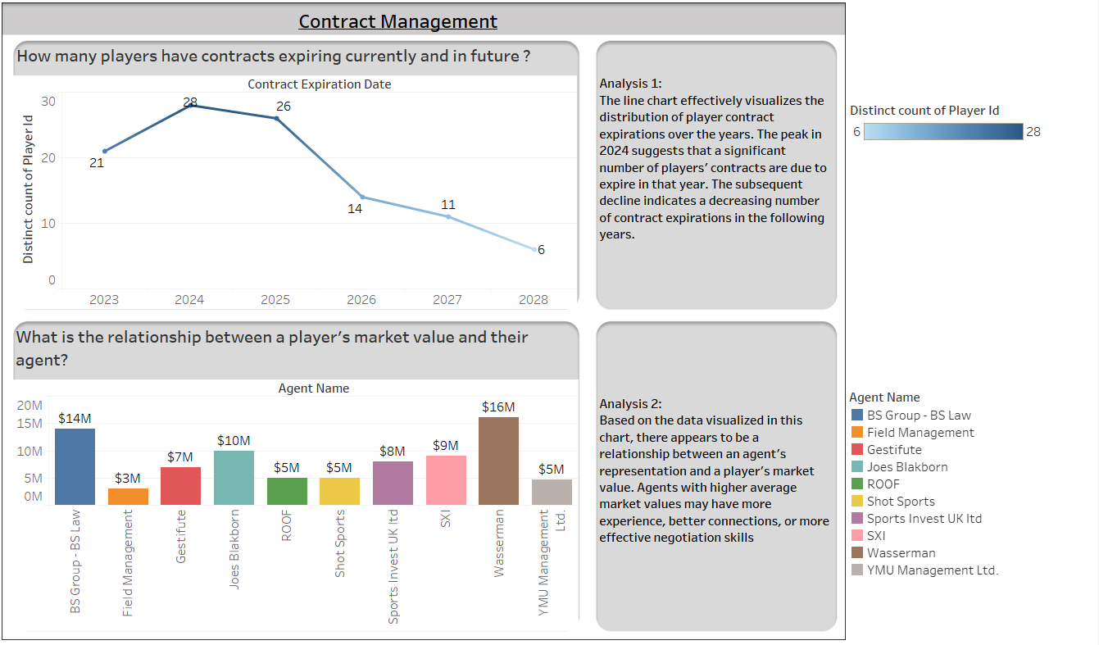

Slide 15
Ques. Can we predict whether a player is the team captain based on their playing position, number of minutes played, and market value?
The model uses Logistic Regression, a statistical method for predicting the probability of an event occurring.
Model Details
Features selection: position_x, minutes_played, market_value_in_eur
Target Variable: team_captain
Purpose:
The purpose of the Logistic Regression model in this context is to predict whether a player is the team captain based on their playing position, number of minutes played, and market value. This information can be valuable for various stakeholders, including Team Managers, Sports Analysts, Sports Betting.
Conclusion:
The logistic regression model appears to be a valuable tool for predicting team captains based on the given features. It can provide valuable insights for teams in areas such as player selection, contract negotiations, and team building.

Slide 16
Can we predict the type of event (e.g., goal, substitution) that occurs during a game based on match dynamics such as minute, player performance, and team?
The model used here is KNN Classifier.
Model Details
Features selection: minute, goals, assists, yellow cards, red cards, home club goals
Target Variable: type_x
Purpose:
The purpose of this KNN model is to predict the type of event (e.g., goal, substitution) that occurs during a game based on match dynamics such as minute, player performance, and team. In simpler terms, it tries to guess what will happen next in a game based on what's happening now and what has happened before.
Conclusion:
The KNN model is performing well in predicting event types in sports games, with an accuracy of around 86% based on the available data. This means that for 86 out of every 100 events, the model correctly predicts the type of event (e.g., goal, substitution). Overall, the KNN model demonstrates promising performance in this task. However, it's important to note that the performance of the model might vary depending on the specific dataset and the complexity of the problem.

Slide 17
How do both performance (goals) and non-performance factors (attendance, name, shirt number) impact a player's market value?
Multiple linear regression model is being used here.
Features selection: goals, highest market value in eur , attendance , number
Target variable: market value in eur
Purpose:
The model is trying to predict a player's market value based on factors like how many goals they've scored, how many people watch their games, and even their name and shirt number. It's like trying to figure out how these things together affect how much a team would be willing to pay for that player.
Conclusion :
Overall, the scores suggest that the model is doing a pretty good job of predicting player market values based on the factors considered. It can explain a significant portion of the variation in market value and is making reasonably accurate predictions. However, there's always room for improvement, and you might consider adding more factors or trying a different model to see if you can get even better results.

Slide 18
Question: Can we group players based on their performance metrics such as goals scored, assists, and minutes played?
K-means model is being used here.
The columns I have used in this model to predict is goals, assists, minutes played.
Purpose :
The purpose of the K-means clustering model you provided is to group football players based on their performance metrics. It helps to identify different types of players based on how they play.
Imagine you have a bunch of football players. You want to sort them into different teams based on how well they play. The K-means model can help you do this by looking at their goals, assists, and minutes played. It will group players together who have similar playing styles.
This can be useful for coaches and teams to understand the strengths and weaknesses of different players and to strategize accordingly.
Conclusion :
Overall, the K-means model demonstrated its ability to provide valuable insights into player groupings and can be used for further analysis and decision-making in the context of basketball performance.

Slide 19
Summary of the Football Data Capstone Project
This project aims to analyze various aspects of football using data-driven models to improve decision-making for teams, coaches, and analysts. Key areas explored include:
Performance Analysis: Tracking key performance metrics such as goals and match attendance to improve team performance.
Player Profile and Market Value: Understanding factors like nationality, position, and team association that influence a player's market value.
Team Comparison: Comparing teams' goal-scoring patterns and financial metrics to help with team-building and strategy planning.
Attendance and Stadium Analysis: Analyzing the relationship between stadium attendance and home team performance to improve fan engagement.
Referee Analysis: Studying the influence of referees on match outcomes, including disciplinary actions like yellow and red cards.
Substitution Patterns: Analyzing the impact of player substitutions on match outcomes to optimize in-game decisions.

Slide 20
Event Analysis: Examining the occurrence of match events such as goals, fouls, and corners to identify winning strategies.
Competition Analysis: Assessing team performance across different competitions to help teams strategize for different levels of competition.
Player Attributes and Demographics: Understanding how player characteristics like age, nationality, and playing position influence their market value and performance.
Contract Management: Managing player contracts by analyzing performance trends and contract timelines to avoid financial over-commitment.
The project used various models to predict specific outcomes:
Logistic Regression to predict whether a player is the team captain based on their position, minutes played, and market value.
K-Nearest Neighbors (KNN) to predict different event types (e.g., goals, substitutions) based on match dynamics.
Multiple Linear Regression to estimate a player’s market value based on performance and attendance.
K-Means Clustering to group players by their performance metrics like goals, assists, and minutes played.

Slide 21
Conclusion
The project successfully demonstrated the power of data analytics in football. By using statistical models, various aspects of the game, such as predicting team captains, event types, and player market value, were analyzed effectively. The models provided insights that can assist football teams in player acquisition, performance improvement, and strategic decision-making. However, the performance of the models can be improved by adding more features or experimenting with alternative algorithms, which could lead to more accurate predictions and deeper insights into the game.

Slide 22
THANK YOU

